Slide 1
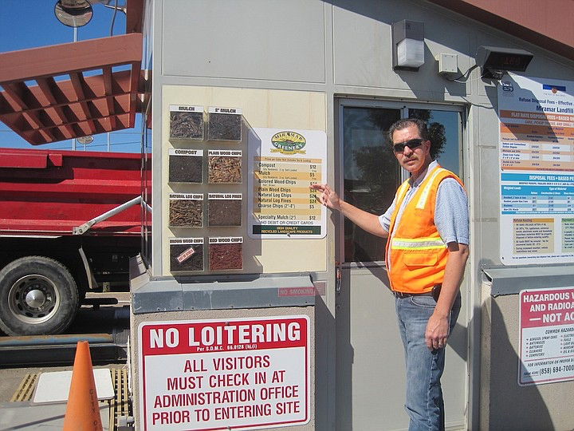
The Economics of the Compost Business
Notes:
Transforms a difficult to handle material with limited uses into a stable, easily handled, easily stored material with a variety of uses.
Creates a product with value – compost.

Slide 2
“Composting economics refers to the business of composting—how to manage feedstocks and manufacture a marketable product in such a way as to produce a profit.”
Chapter 19
The Composting Handbook
Notes:
Composting revenue comes primarily from fees collected to treat feedstocks (gate or tip fees) and sales of compost products.
However, several direct and indirect benefits from composting can lead to internal savings that enhance the value of composting.

Slide 3

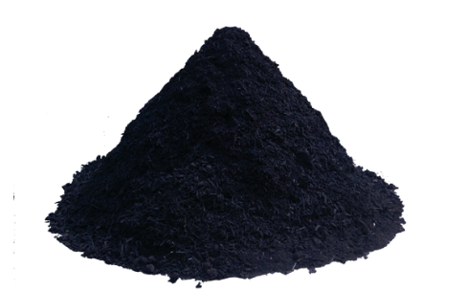

Commercial Compost Equation
75 – 80%*
20 – 25%*
Feedstock
Manufacturing
Product Sales
$
$
$
*CalRecycle, 2019.
YMMV
Notes:
Cotton, 2019, 80% of revenue comes from feedstock acceptance fees
YMMV – Your Mileage May Vary

Slide 4
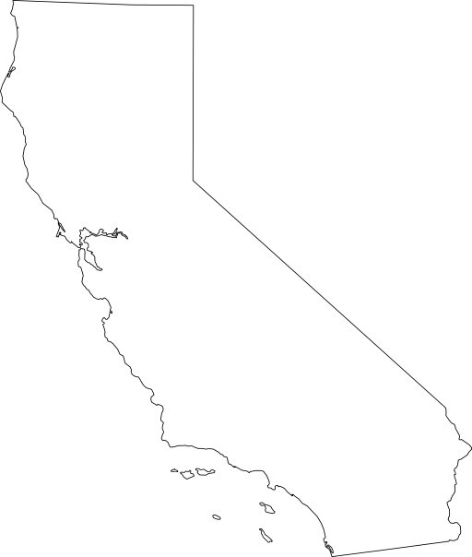
Significant Range
California (2019)
100% charge tip fees
100% percent sell compost
Wisconsin (2012)
87% no tip fee
77% no compost sales
Notes:
Experience in states varies significantly
Even more outside of US

Slide 5
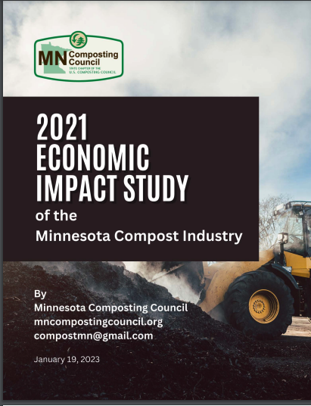
Third Study of the MN Compost Industry
MPCA says +125 sites (mostly yard waste)
Study N=25 (so maybe 1/5th?)
Overwhelmingly publicly operated.
Equal parts compost & mulch (plus soil mixes)
$34 million gross revenue
Lot of variation in business models.
50/50 split in revenue
(Tip fees vs. product sales)

Slide 6
Composting Business Model:
A Four-Way Balancing Act!
Quantity
Quality
Pre-Processing
Composting
Post-Processing
Supply
(Feedstocks &
Contaminants )
Demand
(Products)
Revenue
Cost
Source: Kessler Consulting, Inc.

Slide 7
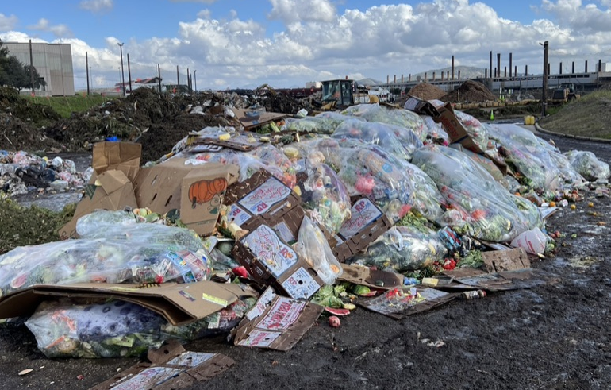
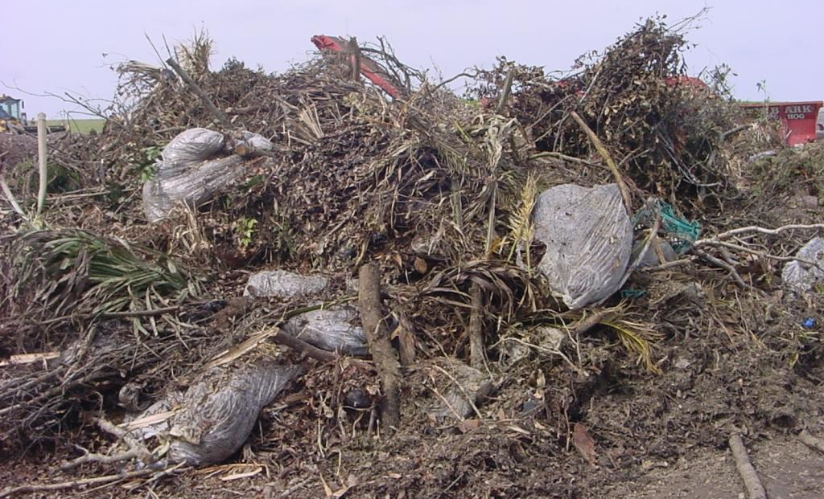

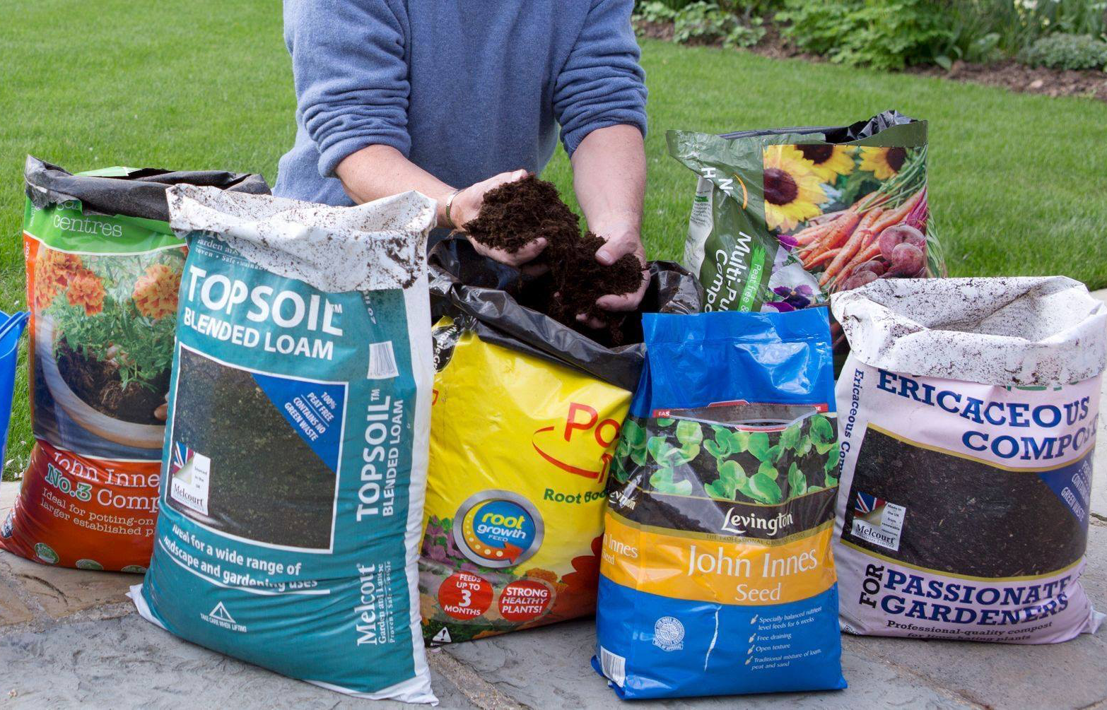
Quality In – Quality Out
(not GIGO)

Slide 8
Typical Income and Expense Items
Revenue | Expense
Gate Fees Compost/Mulch Sales Sales of Related Services (grinding, trucking, spreading) | Land Labor Fuel Debt Service Cost of Amendments Management and Admin. costs Hauling and Application costs Permitting
Notes:
Compost production involves manufacturing-type expenses—debt service, processing, product quality control, labor, health and safety, marketing, and environmental protection.

Slide 9
Economic Drivers
CAPEX / OPEX
Revenue
Land Cost
Economies of Scale
BMP Level Required
Water Cost
Permitting/Offsets
Soil Type/Topography
Hauling Distances
Disposal
Labor & Energy
TPY
Tip Fees – Solids
Tip Fees – Liquids
Product Sales – Mulch
Product Sales – Compost
Grants
Slide Credit: Tim O’Neil, Engineered Compost Systems

Slide 10
Pro Forma Analysis
Life-Cycle Costs
Return On Investment
Risk Analysis
ADJUST DESIGN
&
REPEAT AS NECESSARY

Slide 11
“Choosing the location of a composting facility is perhaps the most consequential decision one can make regarding the sustainability of the composting efforts.”
Chapter 10
The Composting Handbook

Slide 12
Site Selection & Facility Design
Profit & Risk
Location Location Location
TPY
Process BMPs
Feed-Stocks
Regs
Markets
Open-Closed
Cost of $
Labor & Energy Cost
Notes:
Its very simple – just balance these interdependent factors

Slide 13
Site Selection
Site Selection EVALUATION
Question #1: Is it even possible to develop a compost facility at the target site?
Question #2: What level of BMP compliance will be required?
Question #3: How many TPY can processed?
Question #4: Can a good business case be made?
Notes:
It is very rare for a developer to have multiple site options these days. They are lucky to have one. The question is, is the site they have in mind viable? If so, what will it cost to develop? How much revenue can be generated? Is there a business case?

Slide 14
Composting Comparisons
Higher $/Ton
Lower $/Ton
Capital
Cost
In Vessel
Aerated Static Pile
Turned Windrow
Static Pile
Higher $/Ton
Lower $/Ton
Operating
Cost
In Vessel
Aerated Static Pile
Turned Windrow
Static Pile
More tons/Acre
Less tons/Acre
Site
Size
In Vessel
Aerated Static Pile
Turned Windrow
Static Pile
*YMMV

Slide 15
Economies of Scale
3,000 TPY
30,000 TPY
Approach
Small static pile
Turned windrow
Land
> 1 hectare
5 hectares +
Labor
1 part-time
+ 3 - 5 people
Equipment
Tractor
Tractor
Turner
Dump truck
Permitting
Maybe not
Most likely
Capital Cost*
Minimal
$100,000’s to $1,000,000s
*not including land costs

Slide 16
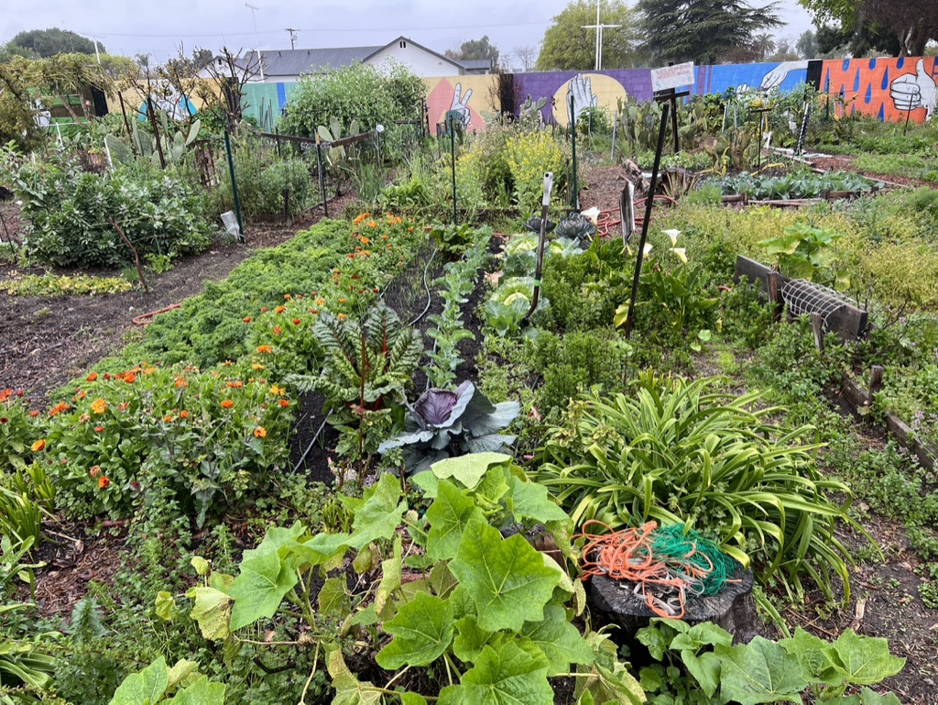
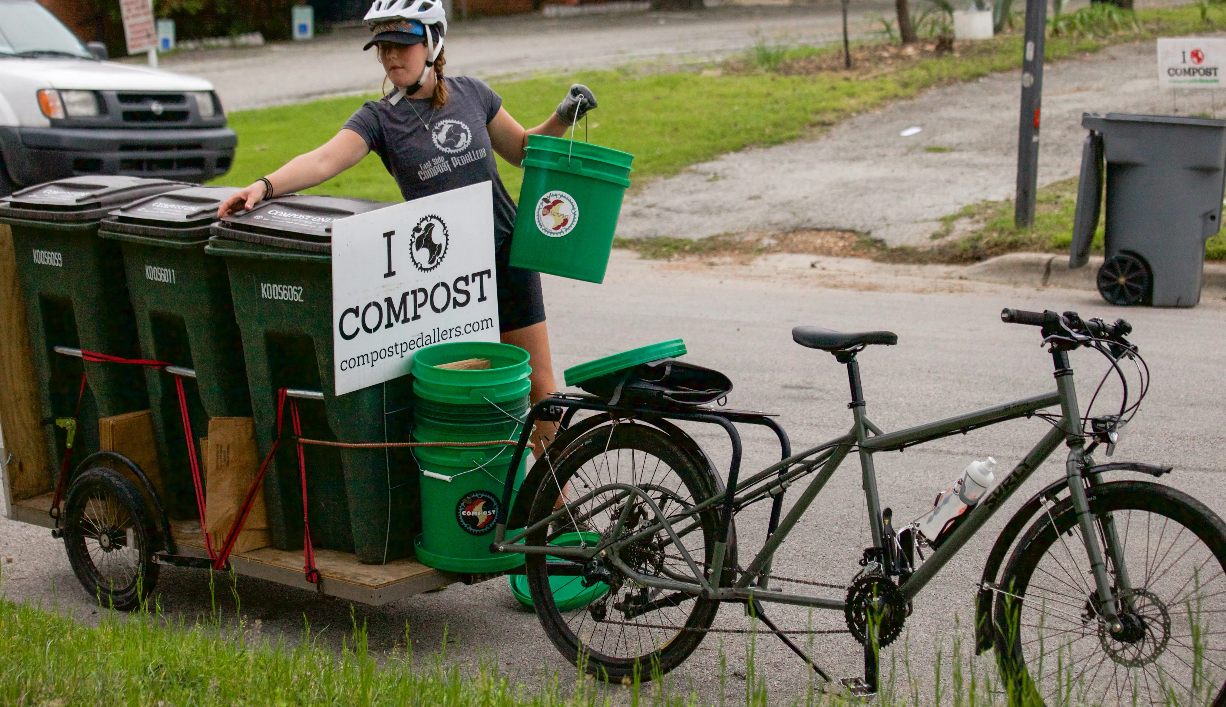
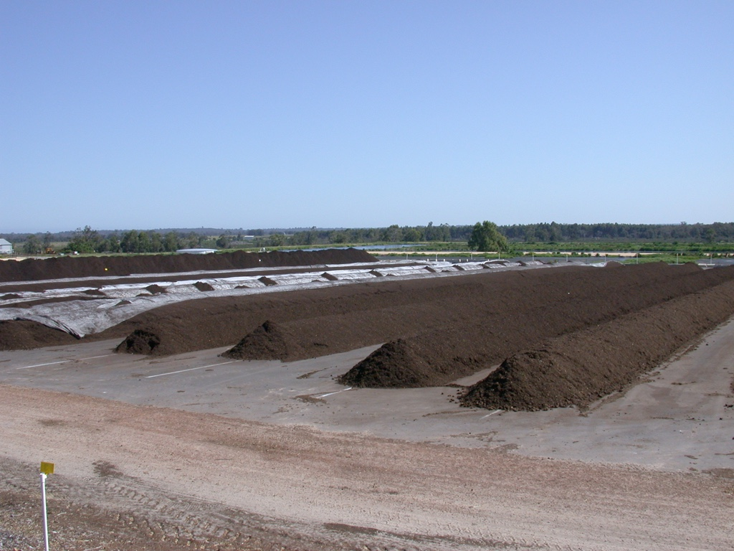
Economics Depend on Scale/Mission
Notes:
Economics will be different depending on scale
Will be different on the farm
Or at the waste management facility
Regulations also drive the economics/

Slide 17


Questions?

