Slide 1
Seal of Testing Assurance program for compost manufacturers
Gowri Sundaram
STA Program Manager/ Database Manager
US Composting Council
gsundaram@compostingcouncil.org

Slide 2
Program history
The program was created in 2000 and is the consensus of many of the leading compost research scientists in the United States.
There is no other compost testing program available to compost producers or compost buyers that give you this type of information.
We are here to help you sell more compost through consistent national lab standards, increased attention to the characteristics of your product, marketing tools, and ultimately increased customer confidence.

Slide 3
Program participation requirements
Meet the US Composting Council’s definition of compost.
Direction of use
Stay in compliance
Lab report – Meet EPA testing limits for Heavy metals & Pathogen
Meet testing frequency
Sign the rules contract – Gateway attestation
Participation fee
Maintain the certification renewals

Slide 4
Participating STA Composters
Complete on-going product testing (4-12 times/year)
-Operate on-going sampling/testing regime, so historical product data is available
-Using uniform sampling and analytical testing methods (from the TMECC)
-Using only STA Program certified labs
Disclose test data results (lab analyses) on uniform label
Provide appropriate end use instructions to end users

Slide 5
Why these Characteristics and Frequencies?
Regularly sample and test their product using standardized protocols
Testing frequency is based on the volume of compost produced
1-6,250 tons 1 per quarter
6,251-17,500 tons 1 per 2 months
17,501 tons and above 1 per month
Compost Parameters | Reported as
pH | N/A
Soluble salts | dS/m (mmhos/cm)
Primary plant nutrients | %, as-is (wet) & dry weight basis
Nitrogen | Total N
Phosphorus | P₂O₅
Potassium | K₂O
Calcium | Ca
Magnesium | Mg
Moisture content | %, wet weight basis
Organic matter content | %, dry weight basis
Particle size | Screen size passing through
Stability (respirometry) | mg CO₂-C/g OM per day
Maturity (Bioassay) -Percent emergence -Relative seedling vigor | % (average) % (average)
Select Pathogens | PASS/FAIL (Per US EPA Class A standards, 40 CFR § 503.32(a)
Trace metals | PASS/FAIL (Per US EPA standards, 40 CFR § 503.13, Table 3)
-Statistical valid testing frequencies prove consistency (and safety)
-Used frequencies from US EPA 503 regulations

Slide 6
STA ‘Enhanced’ Program Testing Package, plus
Compost Parameters | Reported as
pH | N/A
Soluble salts | dS/m (mmhos/cm)
Primary plant nutrients | %, as-is (wet) & dry weight basis
Nitrogen | Total N
Phosphorus | P₂O₅
Potassium | K₂O
Calcium | Ca
Magnesium | Mg
Moisture content | %, wet weight basis
Organic matter content | %, dry weight basis
Particle size | Screen size passing through
Stability (respirometry) | mg CO₂-C/g OM per day
Maturity (Bioassay) -Percent emergence -Relative seedling vigor | % (average) % (average)
Select Pathogens | PASS/FAIL (Per US EPA Class A standards, 40 CFR § 503.32(a)
Trace metals | PASS/FAIL (Per US EPA standards, 40 CFR § 503.13, Table 3)
Parameter | Reason
Sulfur | Only secondary nutrient left off of CTDS (more used in fertilization because less supplied by rainwater)
Chloride and Sodium | Higher levels being found in compost because of post consumer food, potential negative plant growth impact (EC / maturity)
Full nitrogen suite (NH₄, NO₃, total and organic N) | Test for mobile forms of nutrient to alleviate concerns of migration, water pollution
Phosphorus and WEP | Test for mobile forms of nutrient to alleviate concerns of migration, water pollution
Persistent herbicide bioassay | Test to alleviate concerns about presence and potential for plant damage
PFOS and related suite | Test to alleviate concerns about presence and potential for health concerns
Pathogens - Both Fecal Coliform and Salmonella | Test to alleviate concerns about presence and potential for health concerns
DEFENSE PACKAGE – test for extra parameters x times per year
Data for use in sales and to react to ‘negative’ scenarios

Slide 7
GEOGRAPHICAL LOCATION BASED STA PARTICIPATION METRICS

Slide 8
Program Updates
CAP – Compost Analysis Proficiency
Derivative Products
Contract Updates – Fraud Protection
Additional Updates

Slide 9
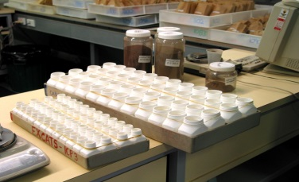
Dr. Miller three times annually in triplicate 3 different blind samples are sent to all participating labs
13 labs currently

Slide 10
STA - Derivative Products
Alternate Named Products
Definition – An enrolled STA certified compost can be marketed under an alternate brand or trade name, with no other modifications to the product.
Alternate Sized Products
Definition – An enrolled STA certified compost or an Alternative Named product can be sold in different screen sizes under a single application, as long as it is sold under the same enrolled name.
Blended Products
Definition – Blended Products containing a STA Certified Compost (as per the STA agreement requirements) may be registered, listed on the USCC STA website, and use the STA Logo for blended products on marketing materials. These products must contain at least 20% (by volume) of a STA Certified Compost and may not contain any non-STA compost.

Slide 11
Derivative Summary

Slide 12
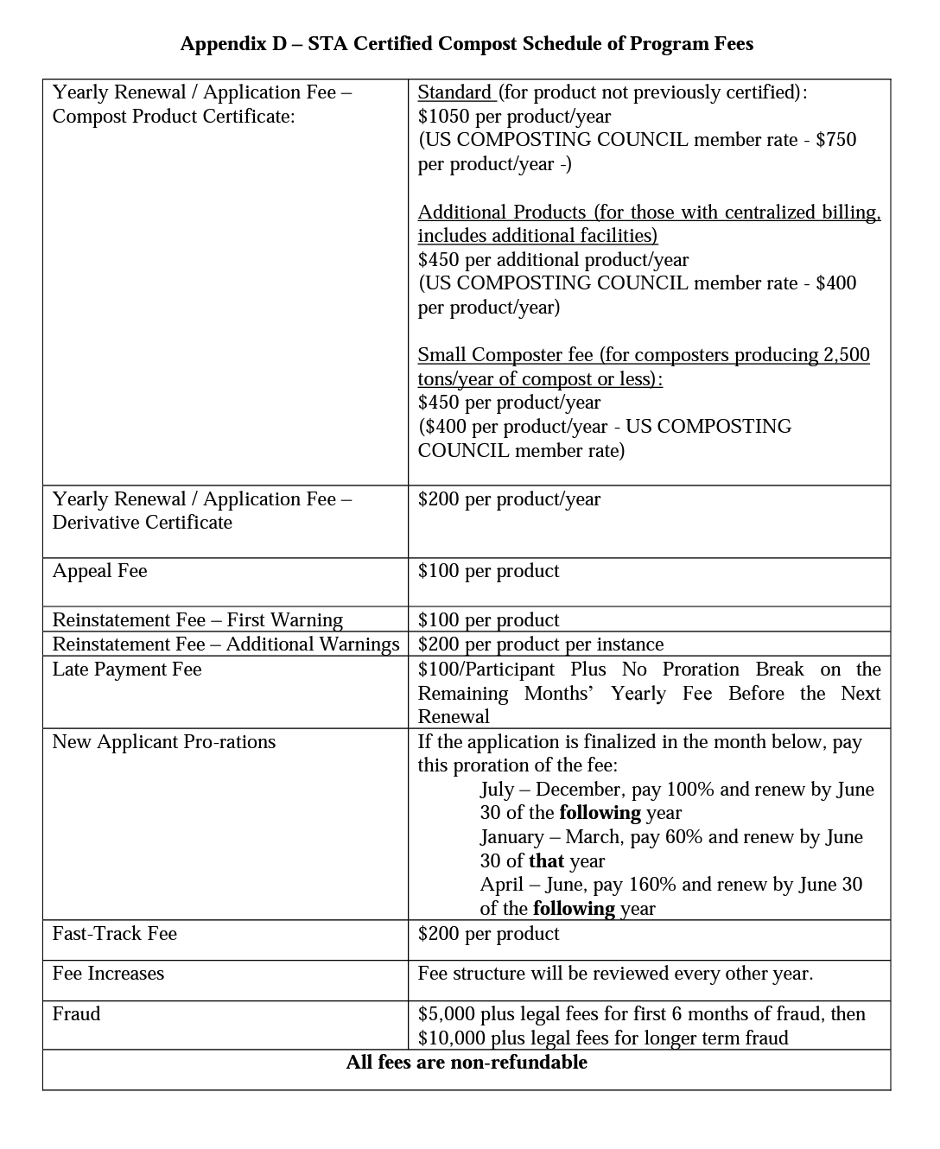
Fraud Protection
Section IX of the Agreement Contact
Fraud Penalties
Copy of Appendix D – Highlight FRAUD

Slide 13
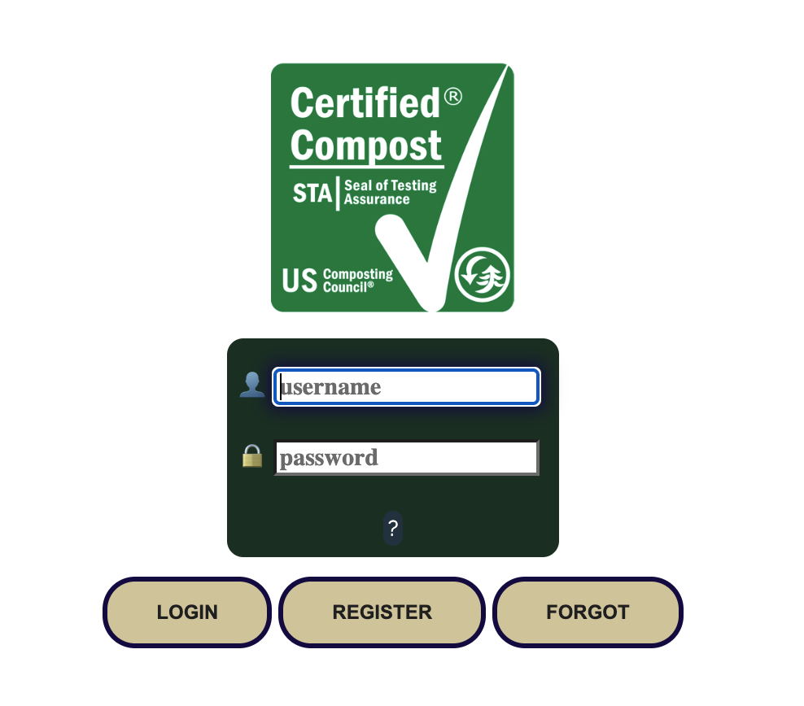
Additional Updates
Updated Compost Definition
WEP – Water Extractable Phosphorus
Program Participation
STA GATEWAY
US Composting Council’s “definition of compost”
US Composting Council’s - American Association of Plant Food Control Officials (AAPFCO)

